Slide 1
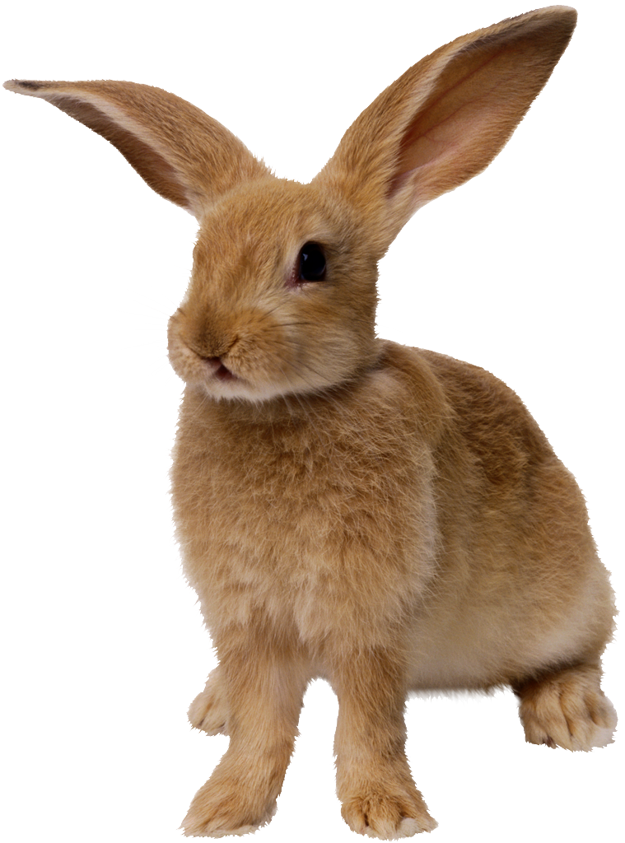
THE BIG
PERSPECTIVE
Mr Joseph Gavagai
- the typological bunny
Hedvig Skirgård
Young Scientists Stockholm
hedvig@lingolympiad.com
Notes:
Some of this is news, some is old.
Raise your hand if you have any questions

Slide 2
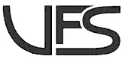
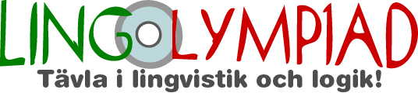
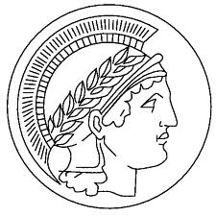
Who am I?
Project leader at
Unga Forskare Stockholm (Young Scientists Stockholm)
Assistant at the Max Planck Institute for Psycholinguistics in Nijmegen, The Netherlands
Master in Linguistics from Stockholm University
(candiatet 3-4 yrs, MA 1-2 yrs, PhD >3-4 yrs)
Focus on general linguistics
grammatical typology, contact linguistics, complexity

Slide 3
!QUIZ!
172 languages are spoken by more than 3,1 million each.
8 by more than 100 millions each
Guess the top-8!
Answer at the end of presentation
NB only native speakers

Slide 4

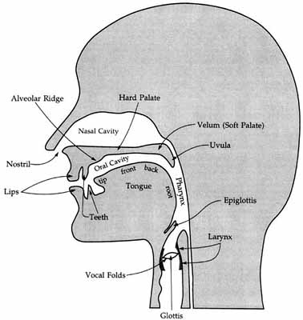
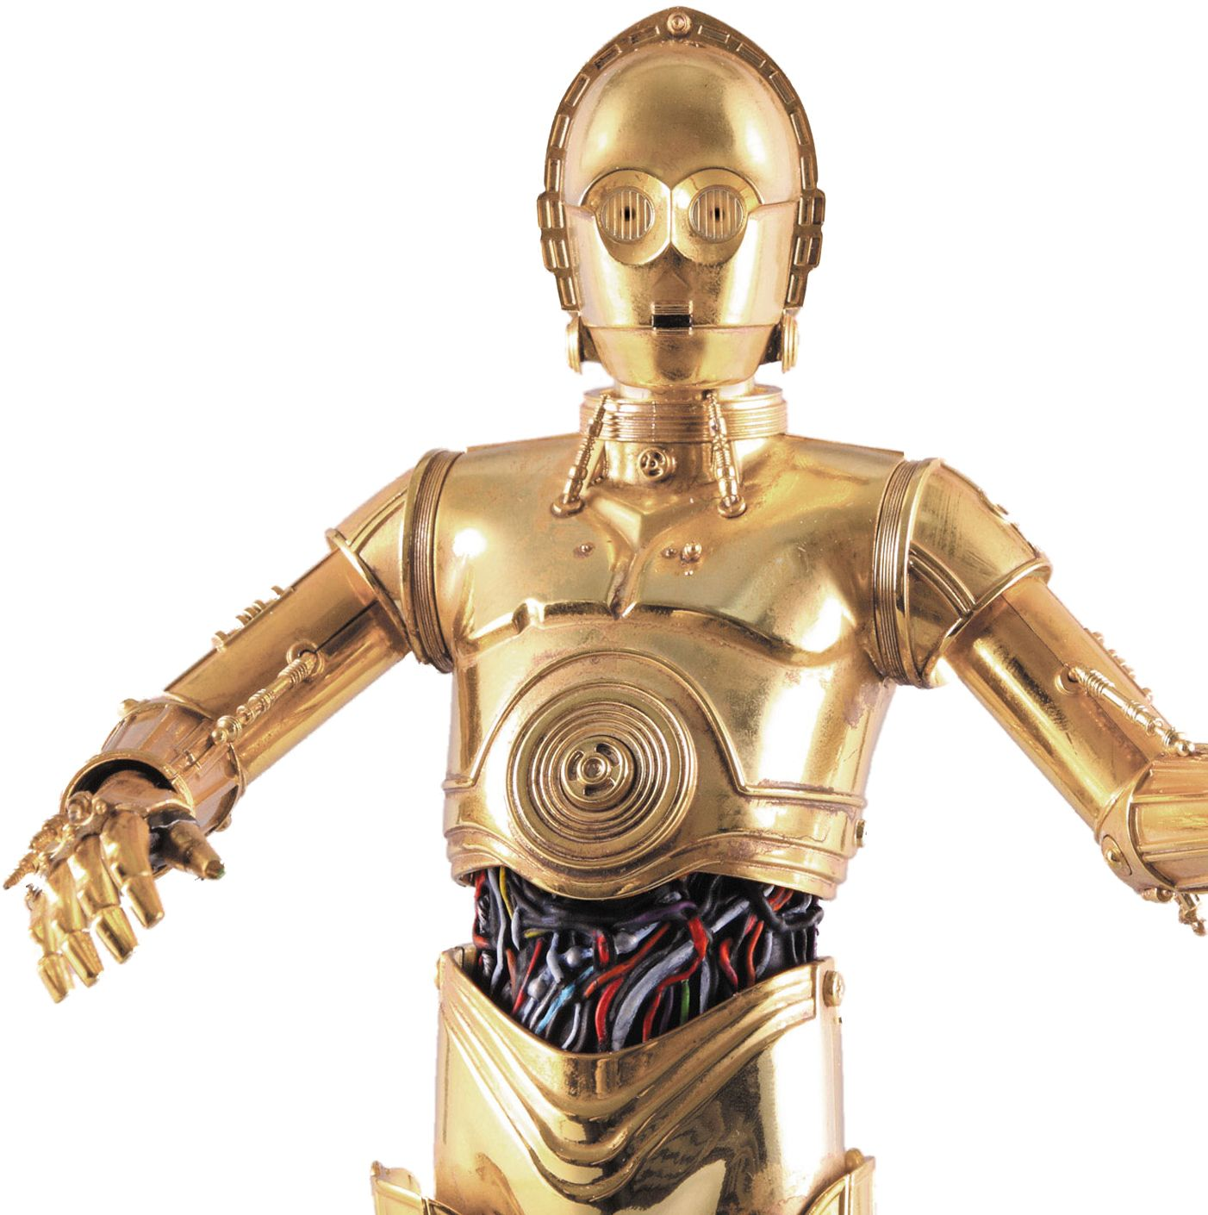
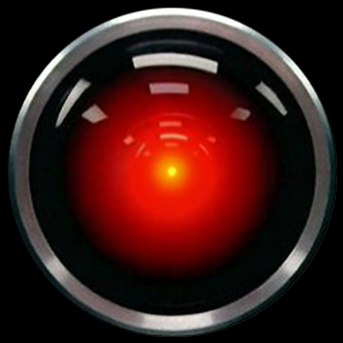
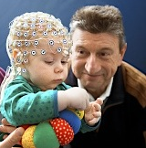
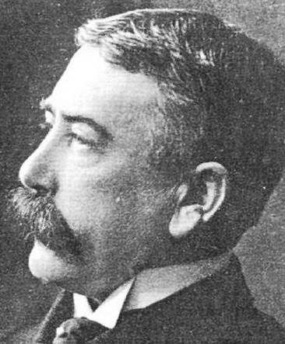
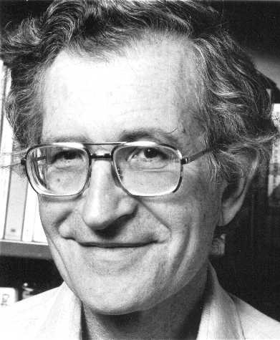
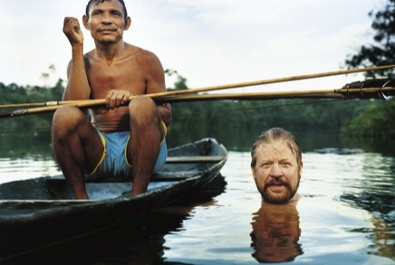
What is linguistics?
Scientific study of language as a phenomenon
Object of study
Ideally: natural, spoken, informally
Often: natural, written, formally
Comptutational
Phonetics
“General”
Pscyholinguistics
Field work

Slide 5
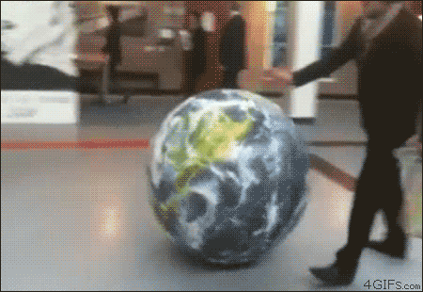
What is language typology?

Slide 6
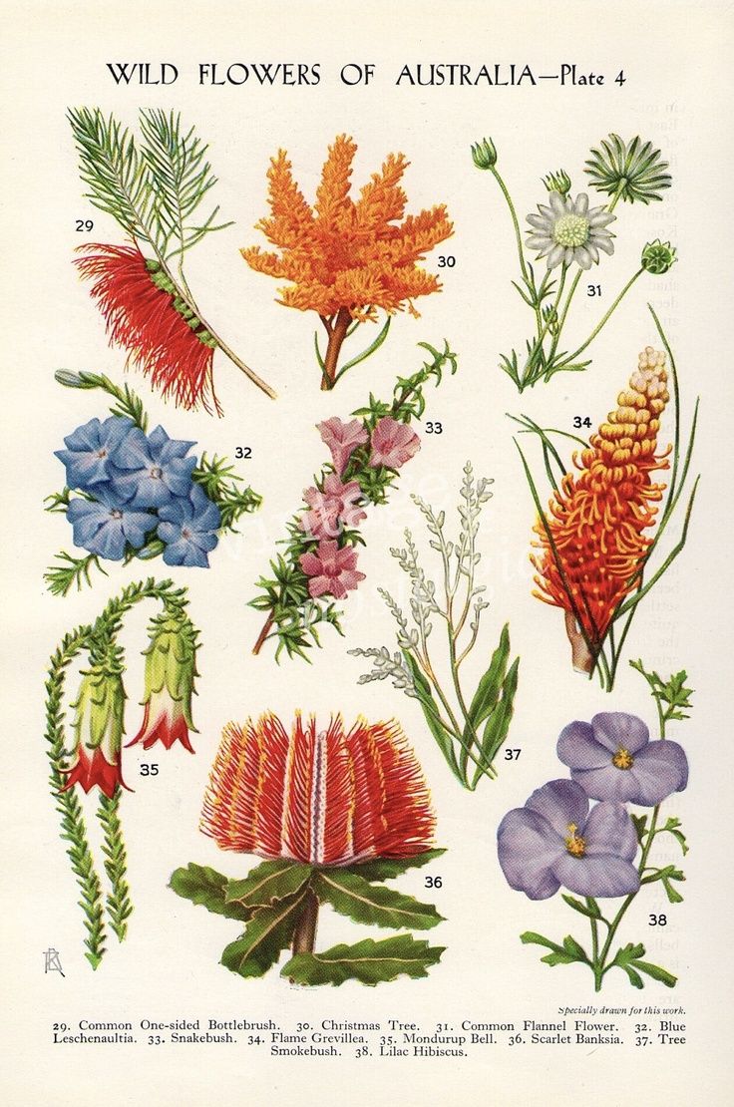
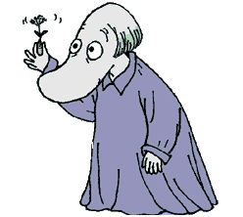
What is linguistic typology?
classifications of languages into types
cross-linguistic comparison
in order to find
patterns due to contact, genealogy and/or implicational biases
Possible leads to mechanisms behind language change and the limits of language
What are the cognitive, areal, cultural, communicative and/or historical constraints on the language diversity, complexity and change?

Slide 7
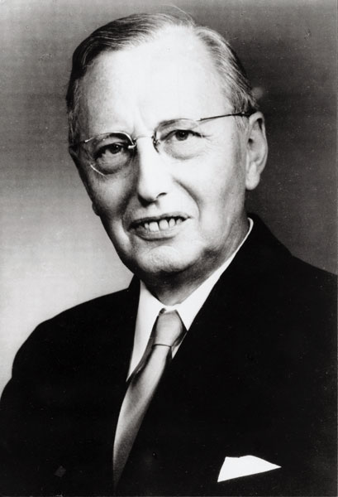
[the aim of linguistic theory] must be to show which structures are possible, in general, and why it is just those structures, and not others, that are possible
(Hjelmslev 1970 [1963]: 96)
Notes:
Some researchers, such as Bickel (2014) and Levinson says that it is not interesting to explore the synchronic sample to answer this question, we must instead “approach the evolution and distribution of linguistic structures from a predictive perspective, starting with the social/historical and biological/cognitive conditions within which languages operate and evolve over time.”

Slide 8
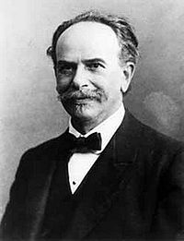
Important to remember!
All languages can express all concepts
grammar [...] determines those aspects of each experience that must be expressed
(Boas 1938:132)
Notes:
Boas Is not in your references, sorry

Slide 9
Other “truths”
However, for most researchers that in their research assume that the opposite is true these distinctions often don’t matter – i.e. they’re most often two small to be relevant. We think...
Every change in form reflects a change in function (meaning) – however small.
Perfect understanding between individuals can never be accomplished
There is no perfect synonymy

Slide 10
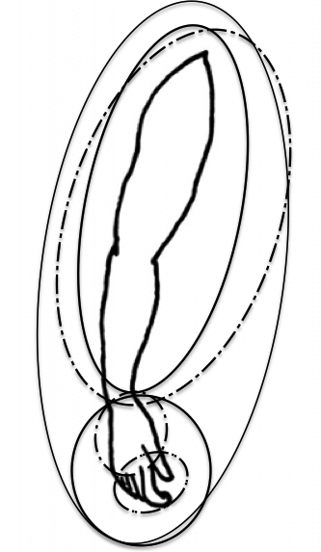
World Atlas of Language Structures (WALS)
Chapter 129: Hand & Arm by Cecil H. Brown 2011
An example of
a typological study
Notes:
WALS is a great typoligical project spanning over 200 languages, at least. Different authors for different phenomena but all are ask to include a set of 200 languages in their study. Some chapters have more, some have less. There is a 400 sample too that is sometimes used.

Slide 11
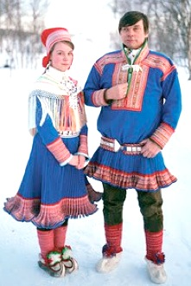
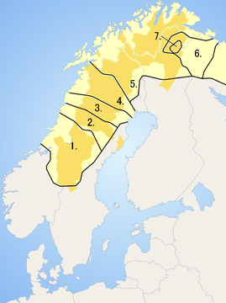
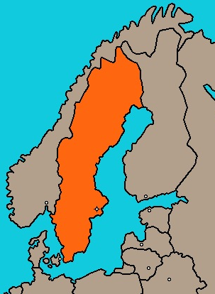
What is a language?
Human & natural (i.e. not mathematics, codes, Klingon or Python)
Linguistic criteria: mutual intelligibility (to a certain extent)
Political issue rather than linguistic
Example
My hovercraft is full of eels
Danish: mit luftpudefartøj er fyldt med ål
Swedish: min svävare är full av ål
Norwegian: min luftputefartøy er full av ål
Icelandic: svifnökkvinn minn er fullur af álum
Faroese: luftpútufar mítt er fult í álli!
(omniglot.com)
1110
1219
1560
1660
1905
SAMI
SWEDISH

Slide 12




What is a language? cont.
IDIOLECT
LANGUAGE A
LANGUAGE B
DIALECT A
DIALECT B
DIALECT C
SOCIOLECT A
SOCIOLECT B
GROUP SLANG A
TELLY WATCHERS
GROUP SLANG B
ACADEMICS

Slide 13
Grain of salt, please
These numbers are based on well-made estimations or large surveys, such as nation wide census’. They will never be perfect or complete.
You’re welcome to ask questions, nothing is too dumb! However, please remember to visit Ethnologue.com, Glottolog.org, WALS.info and the other sites on your own ^^!
Hedvig is not an expert on all of these languages or countries nor an employee of SIL, UNESCO or Glottolog.

Slide 14
There are approx 5 000 – 9 000
languages in the world today
Ethnologue.com (2014)
Summer Institute of Linguistics
7,105 languages in the latest edition
Glottolog.com
Max Planck Institute for Evolutionary Anthropology
Nordhoff, Sebastian & Harald Hammarström & Robert Forkel & Martin Haspelmath
7 786 språk (2014)
Want clues ^^?
193 member states of UN
203 states recognized by at least one UN member state
249 entities of ISO 3166-1
+7 billion humans on Tellus
we’ve had languages for at least 100 000 years
(we’re not sure if language arose in one place or several)
the distribution of speaker populations are Zipfian
How many languages do you think there are in the world today,
approximately?

Slide 15
Handy terms to deal with some of these problems
Ethnologue
Language family
(Macro language)
language
dialect
Cysouw & Good (2003)
Languoid
  language varieties (sociolect, dialect, etc)
glossonym
doculect

Slide 16
Hur många talare?
 | # lgs | % of all lgs | # speakers | % of all speakers
100,000,000 to 999,999,999 | 8 | 0.1% | 2,543,460,358 | 40.4%
10,000,000 to 99,999,999 | 80 | 1.1% | 2,458,383,987 | 39.0%
1,000,000 to 9,999,999 | 305 | 4.3% | 929,591,638 | 14.8%
100,000 to 999,999 | 937 | 13.2% | 294,626,823 | 4.7%
10,000 to 99,999 | 1,811 | 25.5% | 61,556,414 | 1.0%
1,000 to 9,999 | 1,978 | 27.8% | 7,613,358 | 0.1%
100 to 999 | 1,062 | 14.9% | 466,128 | 0.0%
10 to 99 | 338 | 4.8% | 12,944 | 0.0%
1 to 9 | 137 | 1.9% | 541 | 0.0%
0 | 204 | 2.9% | 0 | 0.0%
Unknown | 246 | 3.5%
Totals | 7,106 | 100% | 6,295,712,191 | 100%

Slide 17
Useful sites
Ethnologue
WALS
MultiTree
Omniglot
Glottolog
Phoible
The Universals Archive

Slide 18
How do typology?
Define a variable to be investigated
sample languages
go through the sources
realize that the original variable is ill-defined
become enough (lagom) satisfied and expand sample

Slide 19

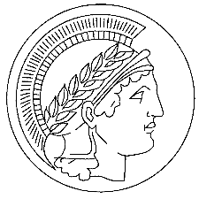

Databases of structural features
 | # languages | # features | datapoints | features with over 200 lgs
Syntactic Structures of the World's Languages (2009) | 237 | 93 | 14 440 | ?
World Atlas of Language Structures (2013) | 2 679 | 165 (192) | 69 590 (76 465) | 129
Nijmegen Typological Survey (2014) | 274 | 279 | 48 435 | 145
Atlas of Pidgin and Creole Language Structures (2013) | 76 | 130 | TBA | N/A
Valency Patterns Leipzig Online Database (2013) | 36 | N/A | N/A | N/A
Phonetics Information Base and Lexicon (2012) | 1 010 | 1 680 | N/A | N/A
South American Indigenous Language Structures (SAILS) | 167 | 604 | 31794 | N/A

Slide 20
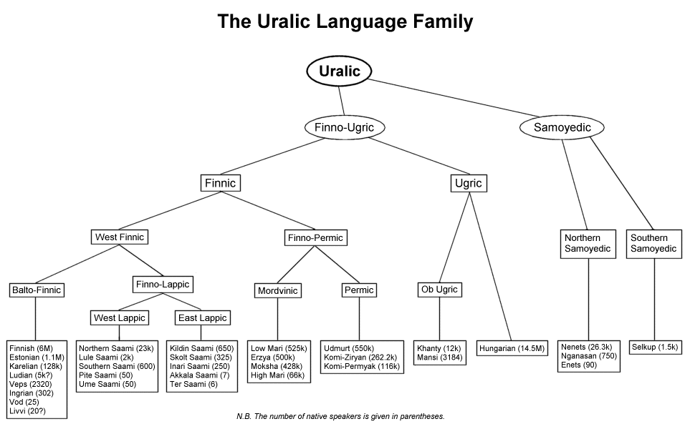
Sampling
All languages: 5-9 000
Unbiased with respect to genealogy or contact
Population size?
Language documentation status?
Genealogy
Contact
Contact
Notes:
Om ni vill lära er fancy pancy ord: diakroni och synkroni

Slide 21
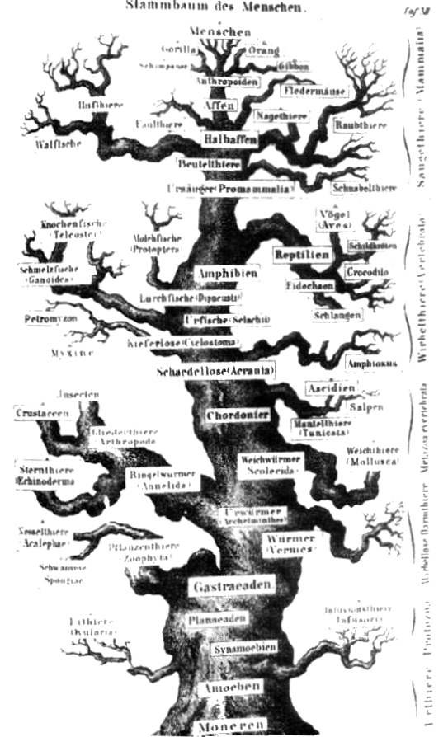
Language families
Nichols (1992) ≈300
Campbell (2009) 250-300
WALS (2011) 212
Ethnologue (2014) 130
Glottolog (2013) 246
How many language families are there?
Notes:
Om ni vill lära er fancy pancy ord: diakroni och synkroni

Slide 22

Language families cont.
How far back can we go.. ?
Nichols (2003)
about the cognate method: 4000-8000 BC
Proto-Uraliska: approx 7000-2000 BC
Proto- Indo-Europeiska: approx 3700 BC
Proto-Dravidiska: approx 500 BC
Genus
– term from WALS
group of languages with a shared history at least 3 500 – 4 000 years ago
WALS innehåller 510 genera
Ex: slavic, germanic, semitic,bantoid
Notes:
Om ni vill lära er fancy pancy ord: diakroni och synkroni

Slide 23
More on language families
6 languages families include 63% of all languages and
are spoken by 85% of the worlds population
Language families | # languages | % of world population of languages | # speakers | % of world population of speakers
Niger-Congo | 1 526 | 21,47% | 435 432 213 | 6,92%
Austronesian | 1 222 | 17,20% | 346 489 508 | 5,50%
Trans-New-Guinea | 476 | 6,70% | 3 540 024 | 0,06%
Sino-Tibetan | 455 | 6,40% | 1 268 218 984 | 20,14%
Indo-European | 437 | 6,15% | 2 925 253 210 | 46,46%
Afro-Asiatic | 367 | 5,16% | 374 573 409 | 5,95%
Total | 4 483 | 63,09% | 5 353 507 348 | 85,03%

Slide 24
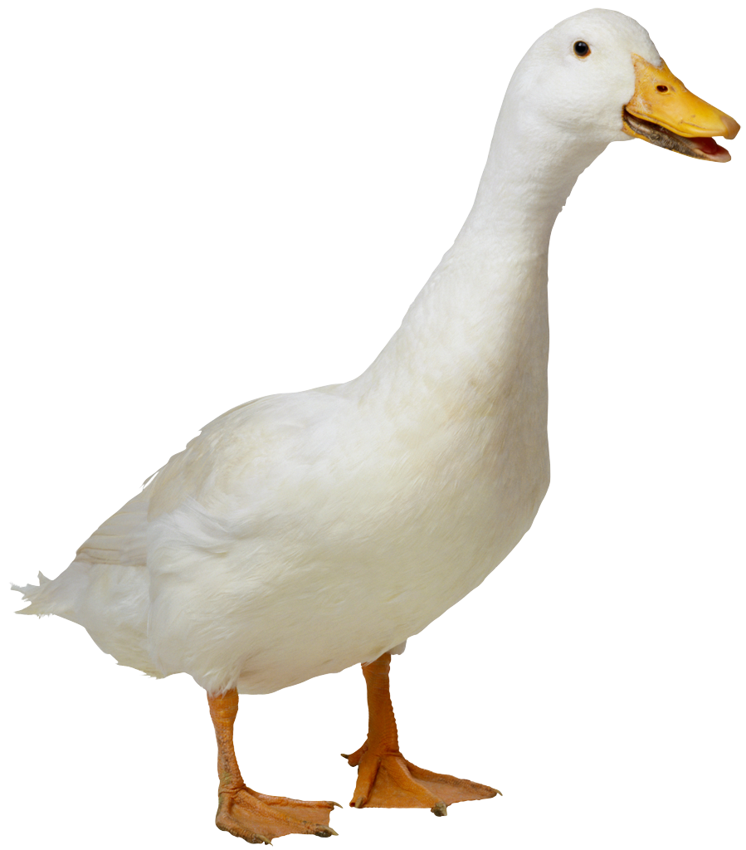
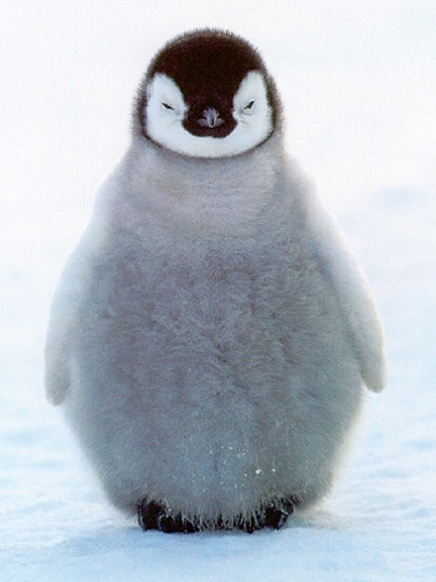
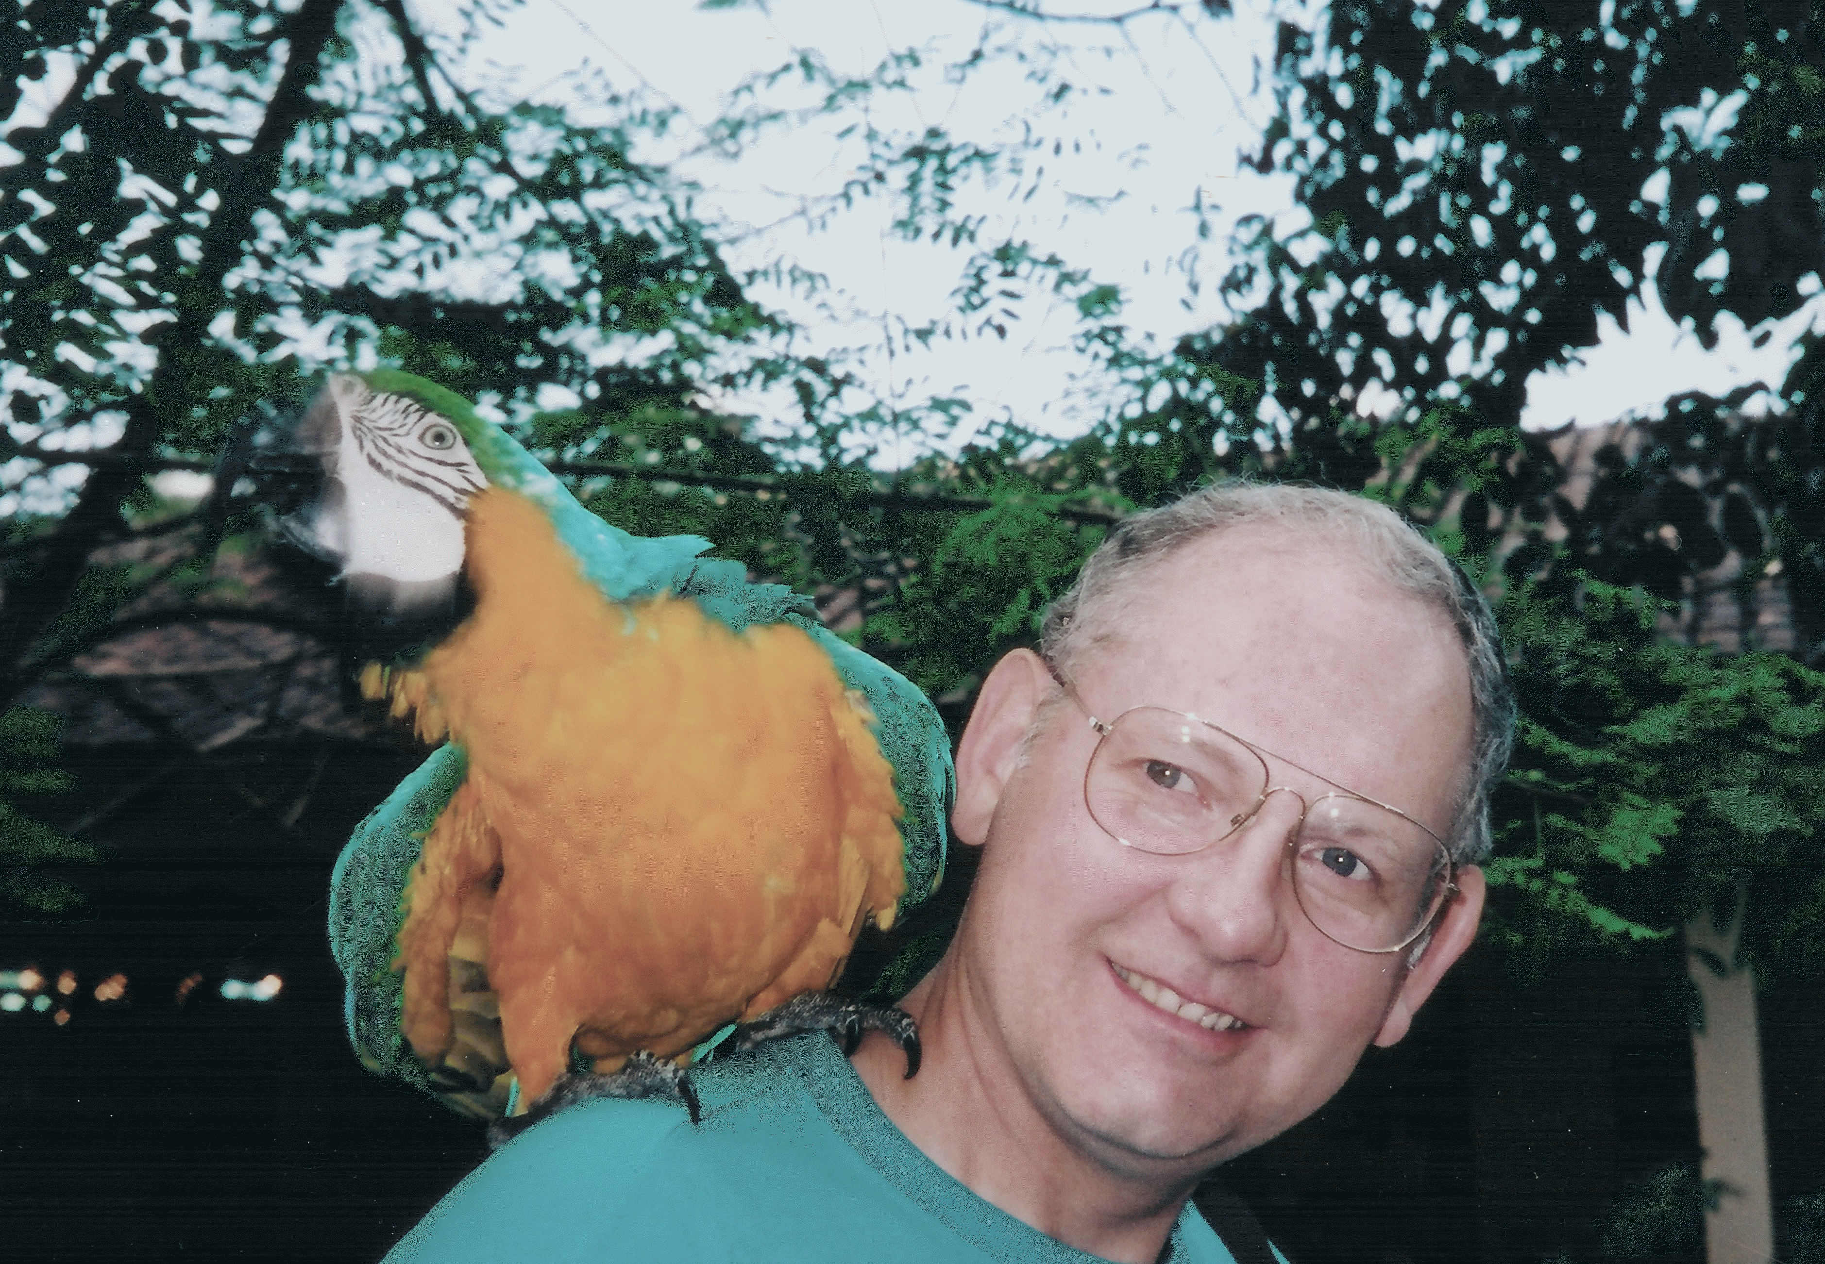
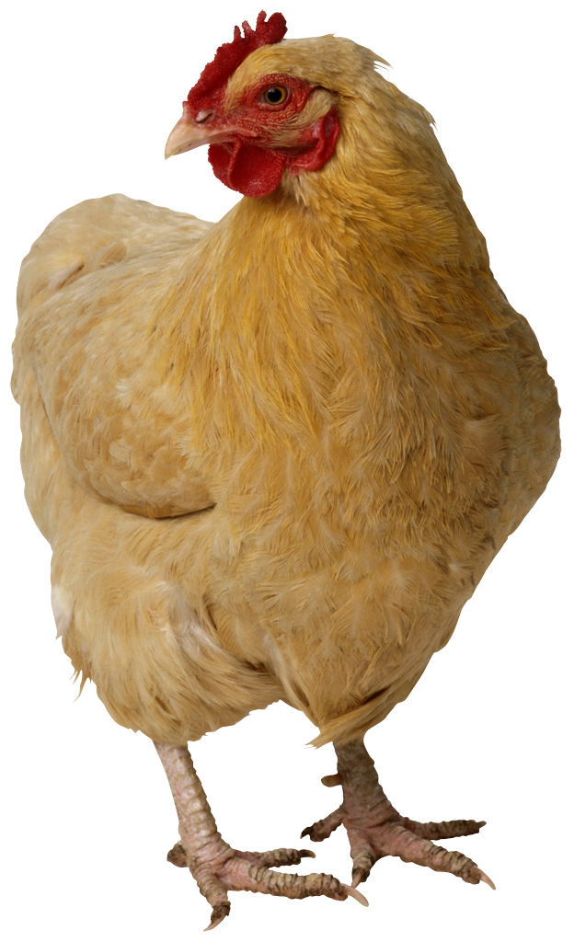
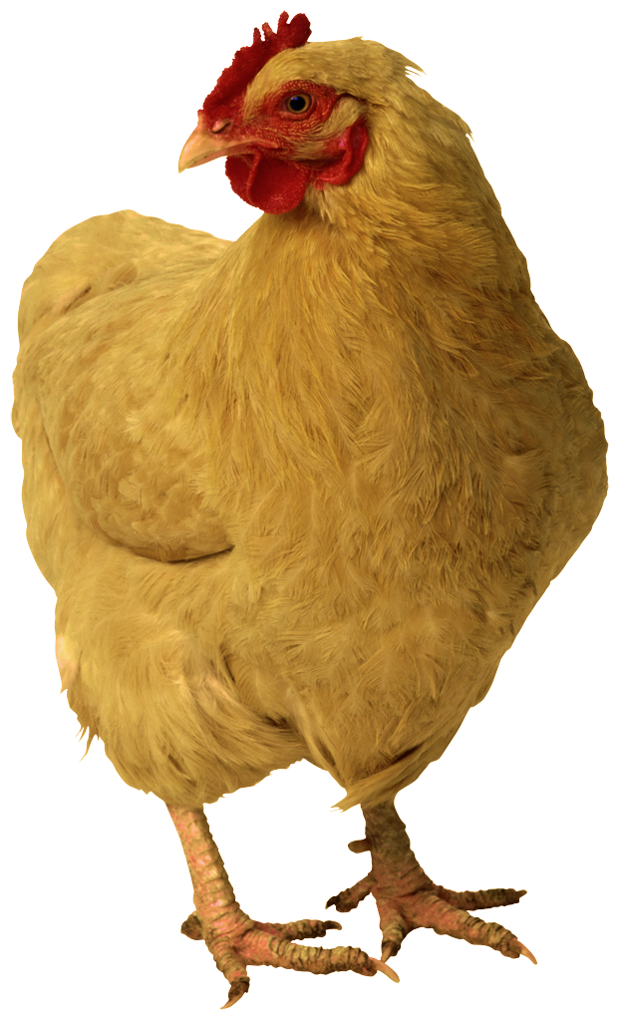
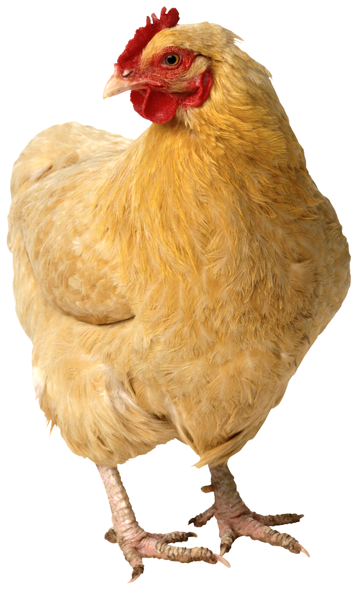
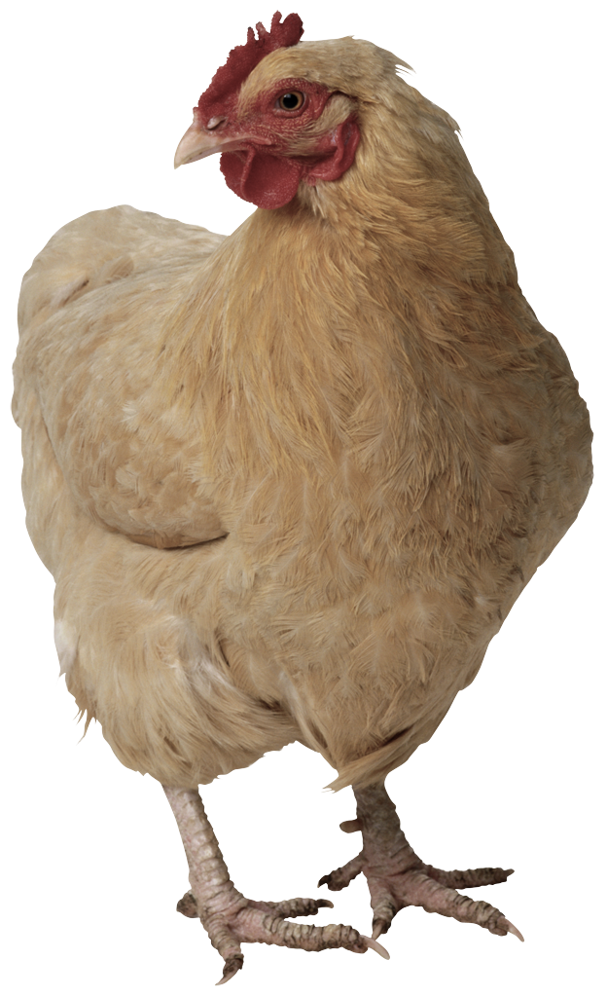
How many isolates?
What should we do about
“very small families”?
An isolate is a language with no known relatives
Ethnologue (2014) 74
Glottolog (2014) 189
Campbell (2009) 129
Basque
Korean
Language family A
Isolate
Burushaski
Language family B

Slide 25
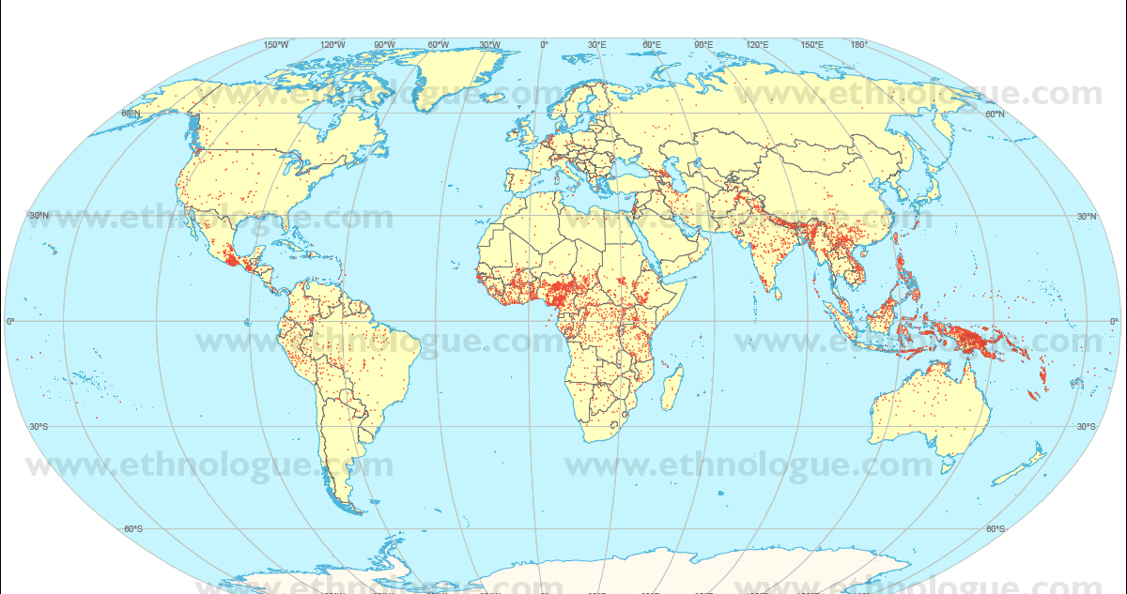
Sampling cont: geography
Macroarea | Living languages |  | Speaker population
 | Number | Percent of totalt | Number | percent of total
Africa | 2,146 | 30.2 % | 997,320,660 | 15.9 %
Americas | 1,060 | 14.9 % | 946,060,483 | 1.5 %
Asia | 2,303 | 32.4 % | 4,086,262,000 | 65.5 %
Europe | 285 | 4.0 % | 735,669,330 | 11.7 %
Pacific | 1,312 | 18.5 % | 35,284,389 | 0.1 %
Total | 7,106 | 100 % | 6,236,421,567 | 100 %
Kaukasus
Central amerika
Himalaya
Amazonas
Centrala/västafrika
Karta från Ethnologue.com Lewis (2009)
Papa Nya Guinea

Slide 26

Participating countries in IOL 2014
Country | # lgs | GDI
India | 449 (442) | 0.913
Pakistan | 76 (71) | 0.795
Singapore | 32 (24) | 0.756
Kazakhstan | 44 (41) | 0.699
Latvia | 14 (7) | 0.628
Canada | 172 (88) | 0.601
China | 301(298) | 0.511
Taiwan | 26 (21) | 0.489
Estonia | 10 (4) | 0.445
Ukraine | 42 (24) | 0.420
Turkmenistan | 27 (4) | 0.385
United States | 420 (215) | 0.334
Netherlands | 38 (15) | 0.301
Spain | 22 (15) | 0.277
Country | # lgs | GDI
Russia | 137 (105) | 0.251
Bulgaria | 17 (11) | 0.217
Australia | 244 (213) | 0.211
Slovenia | 10 (8) | 0.160
Sweden | 23 (13) | 0.153
UK | 55 (13) | 0.144
Greece | 23 (16) | 0.134
Czech Republic | 18 (10) | 0.096
Hungary | 17 (15) | 0.086
Ireland | 5 (5) | 0.067
Poland | 19 (14) | 0.065
Brazil | 224 (211) | 0.054
Japan | 13 (12) | 0.036
Isle of Man | 2 (2) | 0.000
GDI stands for the Greenbergs Diversity Index
High GDI = unlikely that two people in that country speak the same language natively.
Low GDI = likely

Slide 27
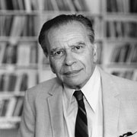
Universals
Joseph Greenberg (1915-2001)
founder of modern typology
genealogical classification
The Universals Archive
Absolute universals (297/2029)
“all languages have X”
Dependent universals (1476/2029)
“if a language has X, if also has Y”
Hierarchies
singular>plural>dual>trial
(Greenberg 1963, universalie 511)
Notes:
Boas Is not in your references, sorry

Slide 28
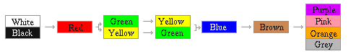
Exemple of universals
Universal 1175 (Brown 1993)
IF there are terms for ‘north’ and/or ‘south’, THEN there are terms for ‘east’ and/or ‘west’
Implicational hierarchy
Berlin & Kay (1969)
Dryer (1992) VO languages tend to have prepositions and OV tends to have postpositions
Notes:
berling and kay hade 98 språk
WHITE BLACK Stage I 9 languages: 7 New Guinea 1 Congo 1 South India
WHITE BLACK RED
Stage II 21 languages: 2 Amerindian 16 African 1 Pacific 1 Australian Aboriginal 1 South India
WHITE BLACK RED GREEN Stage IIIa 8 languages: 6 African 1 Philippine 1 New Guinea
WHITE BLACK RED YELLOW Stage IlIb 9 languages: 2 Australian Aboriginal 1 Philippine 3 Polynesian 1 Greek (Homeric) 2 African
WHITE BLACK RED GREEN YELLOW Stage IV 18 languages: 12 Amerindian 1 Sumatra 4 African 1 Eskimo
WHITE BLACK RED GREEN YELLOW BLUE Stage V 8 languages: 5 African 1 Chinese 1 Philippine 1 South India
WHITE BLACK RED GREEN YELLOW BLUE BROWN Stage VI 5 languages: 2 African 1 Sumatra 1 South India 1 Amerindian
COMPLETE ARRAY OF COLOURS Stage VII 20 languages: 1 Arabic 2 Malayan 6 European 1 Chinese 1 Indian 2 African 1 Hebrew 1 Japanese 1 Korean 2 South East Asian 1 Amerindian 1 Philippine

Slide 29

Chapter 83: Order of Verb and Object av Matthew Dryer (2011)
Notes:
WALS is a great typoligical project spanning over 200 språk, at least. Different authors for different phenomena but all are ask to include a set of 200 språk in their study. Some chapters have more, some have less. There is a 400 sample too that is sometimes used.

Slide 30
How many do we know anything about?
Common size of typological investigations: 200-450 languages
Type | # Languages
< Grammar | 2580
< Grammar sketch | 1161
< Dictionary | 212
< Phonology | 106
< Text collection | 26
< Wordlist | 1073
< Ethnographic | 78
< Minimal | 21
Unknown | 263
All | 5520
Glottolog

Slide 31
Language death
UNESCO
vulnerable 600
definitely endangered 646
severely endangered 527
critically endangered 577
extinct 231
total 2581
(Revitalized: 3. Cornish Livonian, Manx)
(Moseley 2010)

Slide 32
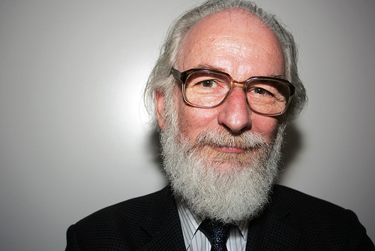
How many are dying?
“Critical limit”: 20 000 speakers
45% of the worlds languages today have less than 20 000 speakers each
Reasonable estimation
>50% will die in 100 years
or even
90% dead or endangered
(Crystal 2000:1)
6% of the languages of the world today are spoken by 94 % of the population
6% of the population of the world today are speaking 90 % of the languages

Slide 33
Why is language typology interesting?
Same species=same brains = same capacity
Yet, great diversity and disparity!
Is something impossible?
What is complexity?
Is complexity even?
What influences ”complexity”?
What does this say about our cognitive capacity and categorize our reality?
(cf pschycology, anthropology, neurology and biology)
Notes:
Boas Is not in your references, sorry

Slide 34
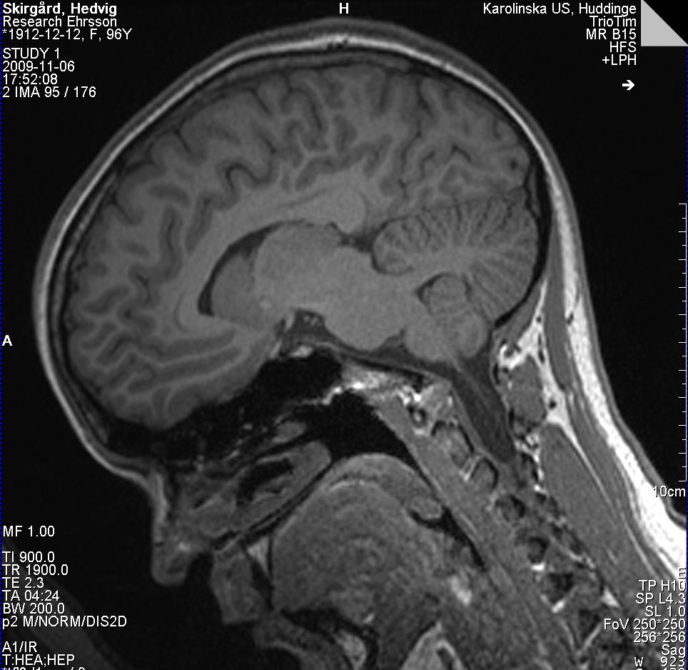
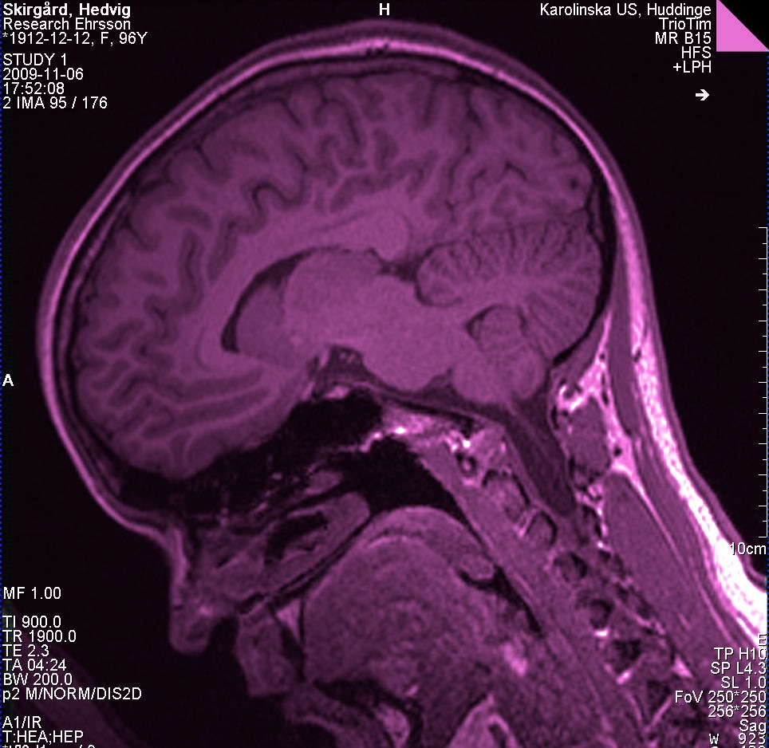
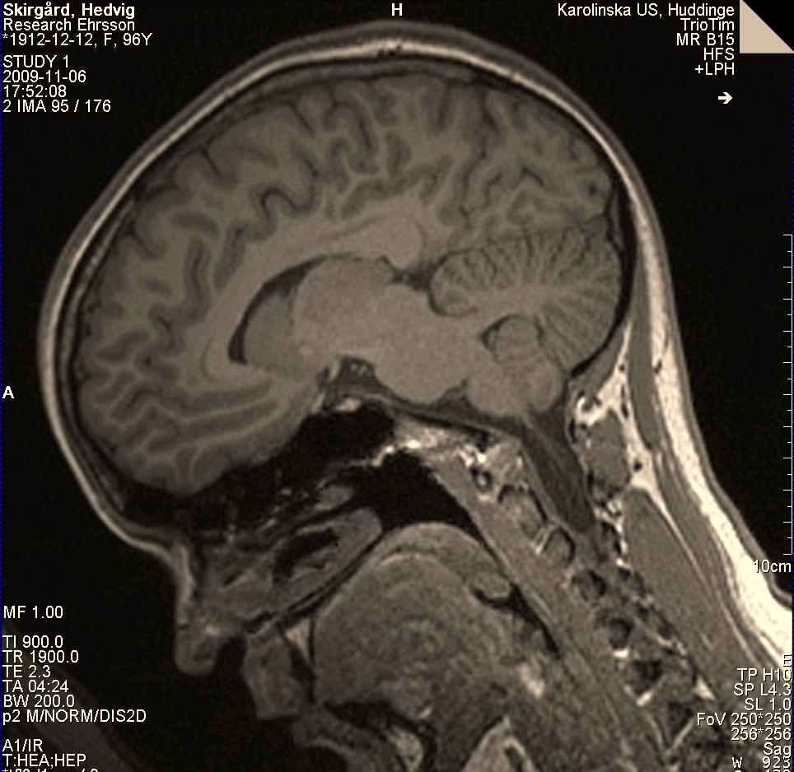
What is going on?
pewqömjsadfskjml
What the heck is going on??!
pewqömjsadfskjml
Notes:
Boas Is not in your references, sorry

Slide 35
Answers to the quiz!
(Ethnologue 2014)
1. ”Chinese” 1,197 millions
2. Spanish 414 millions
3. English 335 millions
4. Hindi 260 millions
5. ”Arabic” 237 millions
6. Portuguese 203 millions
7. Bengali 193 millions
8. Russian 167 millions
1. Mandarin 848 millions
2. Spanish 414 millions
3. English 335 millions
4. Hindi 260 millions
5. Portuguese 203 millions
6. Bengali 193 millions
7. Russian 167 millions
8. Japanese 122 millions
BUT!
Notes:
First of all we got the issue with “macrospråk”
multiple, closely related individual språk that are deemed in some usage contexts to be a single language.
FNs oficiella språk:arabiska, kinesiska, engelska, franska, ryska och spanska

Slide 36
In summary
Linguistics is a very broad field
It’s tricky defining what a language is
There’s a lot of languages, families and speakers
Few speakers speak a lot of languages
There is a great variety of types
We know something about 2500
languages
Most of them are dying
We’ve talked about a lot of things…
and vice versa…
:) or :( ?

Slide 37
Hedvig Skirgård
Unga Forskare Stockholm hedvig@lingolympiad.org
BYE

Slide 38
Referenser 1
Berlin, Brent and Paul Kay (1969) Basic Color Terms: Their Universality and Evolution. Berkeley and Los Angeles. University of California Press
Boas, Franz (1938) Language. In F, Boas (ed), General Anthropology. Boston, Nya York: D.S. Heath and Company
Brown, Cecil H. (1983). Where do cardinal direction terms come from? Anthropological Linguistics 25: 121-161.
Brown, Cecil H.. (2011) Hand and Arm. In: Dryer, Matthew S. & Haspelmath, Martin (eds.) The World Atlas of Language Structures Online. Munich: Max Planck Digital Library, feature 129A. Available online at http://wals.info/feature/129A Accessed on 2012-06-19.
Campbell, Lyle (1998) Historical linguistics - an introduction
Campell, Lyle (unpublished) Language Isolates and Their History, or, What’s Weird, Anyway?
Croft, Willam (1990) Typology and Universals. (Cambridge Textbooks in Linguistics.) Cambridge: Cambridge University Press.
Comrie, Bernard & Dryer, Matthew S. & Gil, David & Haspelmath, Martin. (2011). Introduction. In: Dryer, Matthew S. & Haspelmath, Martin (eds.) The World Atlas of Language Structures Online. Munich: Max Planck Digital Library, supplement 1. Available online at http://wals.info/supplement/1 Accessed on 2012-06-17.
Crystal, David (2000). Language Death. Cambridge: Cambridge University Press

Slide 39
Referenser 2
Dryer, Matthew S.. (2011). Genealogical Language List. In: Dryer, Matthew S. & Haspelmath, Martin (eds.) The World Atlas of Language Structures Online. Munich: Max Planck Digital Library, supplement 4. Available online at http://wals.info/supplement/4. Accessed on 2012-06-17.
Dryer, Matthew S.. (2011) Order of Object and Verb. In: Dryer, Matthew S. & Haspelmath, Martin (eds.) The World Atlas of Language Structures Online. Munich: Max Planck Digital Library, chapter 83. Available online at http://wals.info/chapter/83 Accessed on 2012-12-06.
Gordon, Jr., R. G., editor (2005). Ethnologue: Languages of the World. Dallas: SIL International, 15 edition.
Hammarström, Harald and Nordhoff, Sebastian (2011) How many languages have so far been described? pp. Paper presented at NWO Endangered Languages Programme Conference, Leiden, April 2011
Hammarström, H. (2008). Automatic annotation of bibliographical references with target language. In Proceedings of MMIES-2: Wokshop on Multi-source, Multilingual Information Extraction and Summarization, pages 57–64. ACL.
Hammarström (2009). chapter 5: Counting Languages in Dialect Continua Using the Criterion of Mutual Intelligibility

Slide 40
Referenser 3
Hammarström, H. and Nordhoff, S. (2010). Langdoc: Bibliographic infrastructure for linguistic typology. Oslo Studies in Language 3 (2). Pages: 31–43. (ISSN 1890-9639)
Hammarström, Harald. 2007. The Languages Families of the World: A Critical Synopsis. www.cs.chalmers.se/~harald2/.
Hjelmslev, Louis (1970) Language. An introduction. Madison: The University of wisconsin press [translation by Francis. J Whitfield of Hjelmslev (1963) Sproget. En introduktion. Copenhagen: Berlingske Forlag,
Campbell, Lyle. (2008)Language isolat and Their History, or, What’s Weird, Anyway?. Paper from workshop "The Historical Investigation of Language isolat, or, What’s weird about them?" Spring Workshop in Reconstruction, University of Michigan, April 4-5, 2008.
Lewis, M. Paul, Gary F. Simons, and Charles D. Fennig (eds.), 2013. Ethnologue: Languages of the World, Seventeenth edition. Dallas, Texas: SIL International. Online version: http://www.ethnologue.com.
Maddieson, Ian. (2011a). Tone. In: Dryer, Matthew S. & Haspelmath, Martin (eds.) The World Atlas of Language Structures Online. Munich: Max Planck Digital Library, chapter 13. Available online at http://wals.info/chapter/13 Accessed on 2012-11-19.

Slide 41
Referenser 4
Maddieson, Ian. (2011b). Absence of Common Consonants. In: Dryer, Matthew S. & Haspelmath, Martin (eds.) The World Atlas of Language Structures Online. Munich: Max Planck Digital Library, chapter 18. Available online at http://wals.info/chapter/18 Accessed on 2012-11-22.
Moseley, Christopher (ed.). (2010). Atlas of the World’s Languages in Danger, 3rd edn. Paris, UNESCO Publishing. Online version: http://www.unesco.org/culture/en/endangeredlanguages/atlas
Nichols, J (1992) Linguistic Diversity in Space and Time. Univ. of Chicago Press, Chicago,
Nichols, J (2003) in The Handbook of Historical Linguistics, B. D. Joseph, R. D. Janda, Eds. Blackwell, Oxford, pp. 283–310.
Parkvall, Mikael (2010) Lagom finns bara i Sverige. Stockholm: Telegram bokförlag
Notes:
Kolla Moravcsik, Edith A. (1995). Summing up Suffixaufnahme. In Plank (ed.) 1995, 451-484.
i universals archive

Slide 42
EXTRA-OST?

Slide 43
Chapter 13: Tone
Ian Maddieson 2011
Notes:
Areala drag

Slide 44

Kapitel 18: Absence of Common Consonants av Ian Maddieson 2011 (LÄNK)
Notes:
WALS is a great typoligical project spanning over 200 språk, at least. Different authors for different phenomena but all are ask to include a set of 200 språk in their study. Some chapters have more, some have less. There is a 400 sample too that is sometimes used.

Slide 45
How many languages per country?
Ethnologue facts
Languages per country
Mean 45,6
Median 18
Max 830
(Papua New Guinea)
Min 1
(St Helena, Vatican, North Korea,
Falklands & British Indian Ocean Territory )
Indigenous languages per country
Mean 38,3
Median 10
40 countries have 100% indigenous
830/830
(Papua New Guinea)
Notes:
“Non-indigenous languages are categorized as such if they are spoken by relatively recently arrived or transient populations which do not have a well-established, multi-generational community in the country. The label “Immigrant languages:” is used to introduce a list of known non-indigenous languages in the country. Population estimates if known are shown in parentheses immediately following the language name. These languages are not given their own language entries and are not included in the language counts for that country. Where more general information is known about the presence of immigrant speakers from particular countries or regions (without knowledge of the specific languages), such information is added in a statement that begins with “Also includes.” Given the transitory nature of these populations, this information may be inaccurate or incomplete.”

Slide 46
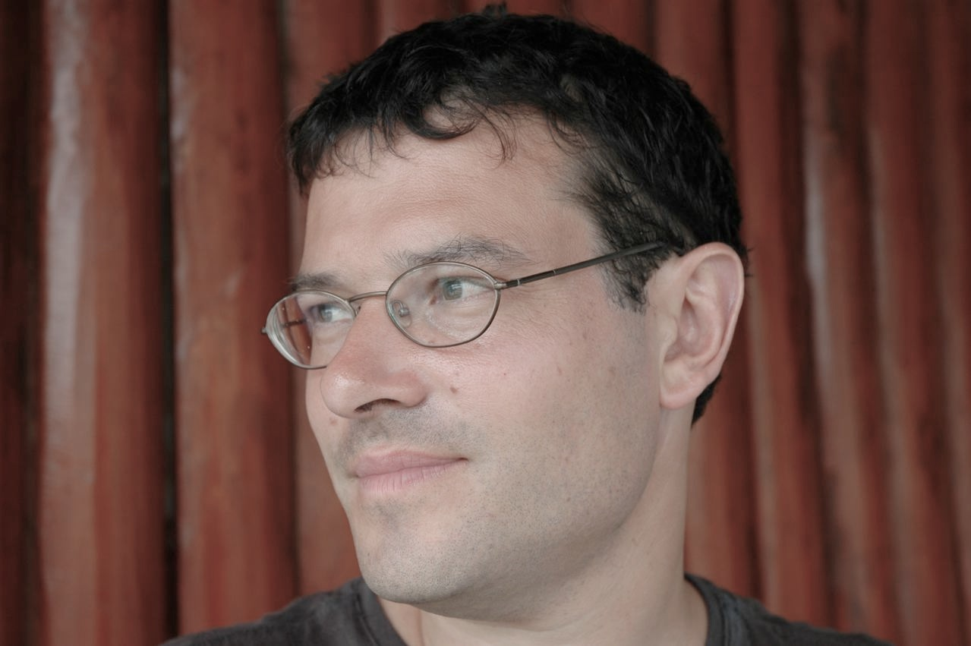
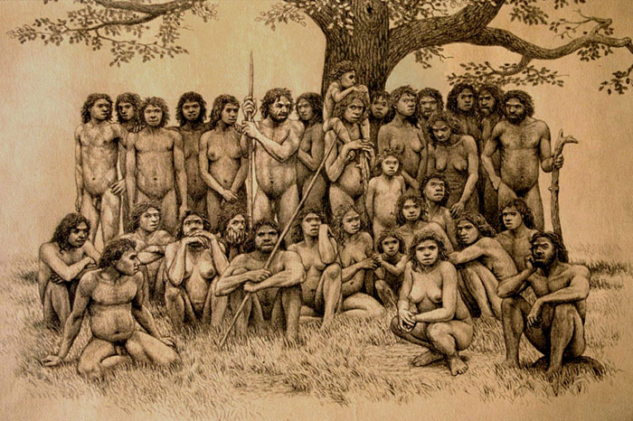
How many has there ever been?
Bickel (p.c. 2012)
If we assume the following
At each point in time there is 5 000 languages
Each language has a lifetime of 1 000 years
We’ve spoken languages for at least 100 000 years
(100 000/1 000) * 5 000 = 500 000
At least half a million!!
This means that
<2 % are alive today

Slide 47
1 language = 1 name?
What’s in a name?
Ethnologue 2005 (Hammarström 2008)
39 419 unique names for languages
42 768 occurrences of these names
mean 5,86 names per language
max the language Armenian has 77 names
mean 1,08 languages per name
max the name Miao refers to 14 languages

Slide 48
KOMBOWALS
(LÄNK)
129: hand & arm
130: finger & hand
Identical = samma ord
Different= olika ord

